Slide 1
Introduction to Programming
Intro to Python Week 6

Slide 2
Purpose of Unit testing
To validate that individual units of source code are working properly
It is executable documentation of the source
By showing what output is expected from given input
Continual quality assurance of the code
Works like a burglar alarm
Doesn't guarantee bugfree code
But catches most unsophisticated bugs

Slide 3
Why Run Unit Tests
Increase confidence in code.
If functionality of code challenged, you can say“the tests passed.”
• Avoid regression.
Know right away if new code breaks old code
• If you write tests first, you know when you’re done
When the tests pass.

Slide 4
When to Run Unit Tests
Always!
Before you check code into repository, so you know your code works.
Before debugging, to ease the process and help you know when you’re done.
This cycle is called Test-Driven Development (TDD)

Slide 5
Unit Testing Process
Installation
Module needed to execute unit tests:
Unittest
Part of the standard Python library
Test Cases
The basic building blocks of unit testing are 'test cases’
single scenarios that must be set up and checked for correctness.

Slide 6
Unit Testing Process
Overview
In PyUnit, test cases are represented by the TestCase class in the unittest module.
To make your own test cases you must write subclasses of TestCase.
An instance of a TestCase class is an object that can completely run a single test method, together with optional set-up and tidy-up code.
Creating class: (not yet covered)
class AnyNameOfClass(unittest.TestCase):
Example
class TestDivision(unittest.TestCase):

Slide 7
Unit Testing Process
Creating Test Cases
Define a method that starts with test_name_of_test
Example
def test_upper(self):
In body of function, make an assertion
assertTrue(), assertFalse, assertEquals()
Example
1)
self.assertEqual('foo'.upper(), 'FOO’)
2)
self.assertFalse('Foo'.isupper())
3)
s = 'hello world'
self.assertEqual(s.split(), ['hello', 'world'])

Slide 8
A Full Example
import unittest
class TestStringMethods(unittest.TestCase):
def test_upper(self):
self.assertEqual('foo'.upper(), 'FOO')
def test_isupper(self):
self.assertTrue('FOO'.isupper())
self.assertFalse('Foo'.isupper())
def test_split(self):
s = 'hello world'
self.assertEqual(s.split(), ['hello', 'world'])
# check that s.split fails when the separator is not a string
with self.assertRaises(TypeError):
s.split(2)
if __name__ == '__main__':
unittest.main()

Slide 9
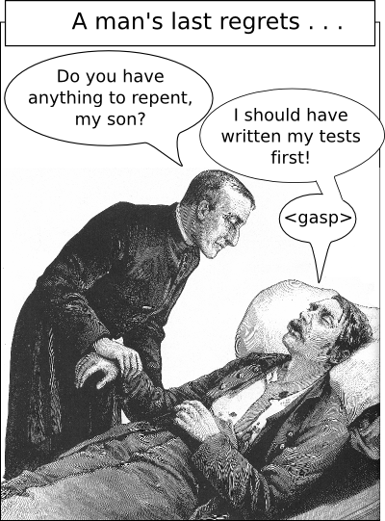
But TDD is very difficult to get used to because it is so counter-intuitive

Slide 10
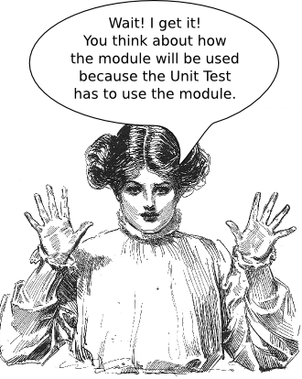
Why Unit tests?
It makes you a better programmer
The design is cleaner
It makes it safer to modify code
Unit tests gives you peace of mind.

Slide 11
About The Mid-Term

